Slide 1
Installing Windows 7
Lesson 2

Slide 2
Objectives
Select the appropriate installation option
Perform a clean installation of Windows 7
Migrate user files and settings to Windows 7
Perform an upgrade to Windows 7
Upgrade Windows 7 editions
Create a dual boot installation
Notes:
Outline the material you are going to cover in this lesson. Do not go into detail as each of these points will be expanded on in the lesson. You may also want to mention the Technology Skills that are being covered for the Certification exam also.

Slide 3
Selecting Installation Options
Will the current hardware support Windows 7?
Will Windows 7 support existing applications?
Which Windows 7 edition should I install?
Should I perform an upgrade or a clean installation?
Should I perform a single or dual boot installation?
Do I have to install multiple languages?
Notes:
Use this slide to have a discussion about each of these Installation Options. Have the students help you figure out how to answer each of these questions.

Slide 4
Understanding the Windows 7 Boot Environment
Previous Windows (XP etc) installations involved
MS-DOS which became increasingly problematic
Windows PE 3.0
A stripped-down operating system based on the Windows 7 kernel that enables system administrators to boot a computer with no installed operating system and initiate the operating system setup process
PE – Pre-installation Environment

Slide 5
Windows PE Advantages
Native 32- or 64-bit support
Native 32- or 64-bit driver support
Internal networking support
Internal NTFS support
Scripting language support
Flexible boot options
Notes:
Describe each advantage of Windows PE, comparing it to the limitations of MS-DOS

Slide 6
What’s New in Windows PE 3.0?
Windows Imaging format
Size reduction
Customization
Hyper-V support
Scratch space
Notes:
Explain the new features of Windows PE 3.0. You may also want to speak about the limitations of Windows PE.

Slide 7
Using Windows PE
Custom deployments
System troubleshooting
System recovery
Notes:
Briefly describe how you would use Windows PE to do each task on the slide.

Slide 8
Performing a Clean Installation
On a new computer that has no operating system
On a computer where you have backed up all data and settings and are replacing the existing operating system
On a computer that has an operating system that is not upgradeable to Windows 7
Notes:
Explain the situations where you would need to do a clean installation. These situations may have come up from your earlier discussion of the Selecting Installation Options slide.

Slide 9
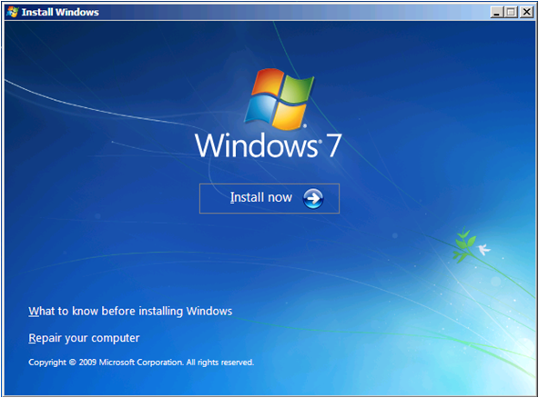
Performing a Clean Installation (cont.)
Boot from your Windows 7 installation DVD
Notes:
Explain how to start an installation from the Windows 7 DVD, and state that you just follow the directions on the screen and provide information as necessary. The procedure is highly simplified compared to previous versions of Windows and requires very little interaction from the installer.
You might want to outline some of the steps, like selecting the partition and creating a new user account.
The steps and screens are outlined in detail in the textbook.

Slide 10
Installing Third-Party Drivers
If, during a Windows 7 installation, no disk partitions or unallocated space appear on the Where Do You Want to Install Windows? page, you must install the appropriate driver for your disk controller.
Notes:
Explain that sometimes Windows 7 will not recognize the hard disk controller in your computer and you must install a driver during the installation procedure. This procedure is much improved since Windows Vista, as the older Windows operating systems installations would require you to know this ahead of time. With the new graphical installation procedure, the installation stops allowing you to install the driver when it is needed.

Slide 11
Migrating to Windows 7
Wipe-and-Load Migration
Side-by-Side Migration
Network
or
Data Transfer Cable
External
Storage
One Computer
Old
Computer
New
Computer
Notes:
Describe the steps and options for each type of migration.

Slide 12
Migrating to Windows 7 (cont)
Type of data you may want to save:
User Accounts E-mail
Documents Videos
Bookmarks Music
Pictures And More
Wipe and Load
Backup your data →Wipe out previous OS (such as XP)
→ Perform clean install → Restore your data
Side – By - Side
Transfer data from one computer to another using Windows Easy Transfer

Slide 13
Migrating to Windows 7 (cont.)
Windows Easy Transfer tool
User State Migration tool
USMT is intended for administrators who are performing large-scale automated deployments.
If you are only migrating the user states of a few computers,
you can use Windows Easy Transfer for computers running Windows Vista® or Windows® 7.
Microsoft TechNet
Notes:
Explain when each tool would be used.

Slide 14
Preparing to Upgrade
Run the Upgrade Advisor
Check hardware compatibility
Search for updated drivers
Check application compatibility
Check disk space
Ensure computer functionality
Perform a full backup
Purchase Windows 7
Notes:
Explain the reason why we should go through each of these steps before upgrading.

Slide 15
Upgrading from Windows Vista
With Windows Vista running, insert the installation DVD.
If it does not Autorun, you can click Setup.exe to start installation.
Make sure to select the UPGRADE option.
Notes:
Explain why you must start the installation from within Vista to do the upgrade. Perhaps explain what happens if you click Clean Install instead.

Slide 16
Upgrading Windows Vista Editions
Purchase full retail version of a higher Windows 7 edition.
Purchase a Windows 7 product upgrade.
Use the Windows Anytime Upgrade tool.
Notes:
Explain the 3 ways you can perform an upgrade from one edition of Windows 7 to another. Review the reason why you can upgrade from any edition to any higher edition and why you no longer need the DVD to perform the upgrade.

Slide 17
Performing a Dual Boot Installation
You need:
Two disk partitions
Two full product licenses
A full system backup

Slide 18
Install Windows 7 in a Dual Boot Environment
Put Windows 7 into the DVD drive. You can boot from it, or put it in while another operating system is running.
Do a Clean Installation.
Select a separate partition for Windows 7.
Notes:
Outline the steps required for performing a Dual Boot installation.

Slide 19
Skills Summary
Windows 7 includes a new pre-installation environment called Windows PE.
In a clean installation, you boot from the Windows 7 setup disk and create or select a blank partition where Windows 7 will reside.
It is possible to migrate files and settings from an existing Windows installation to a newly installed Windows 7 installation using either Windows Easy Transfer or User State Migration tool.
Notes:
Review the Skill Summary to wrap up your lesson.

Slide 20
Skills Summary (cont.)
Windows 7 supports in-place upgrades only from Windows Vista or another Windows 7 edition.
To perform an in-place upgrade, you must launch the Windows 7 setup program from within Windows Vista.
To upgrade from one Windows 7 edition to another, you can use the Windows Anytime Upgrade tool.
A dual boot installation is one in which two operating systems are installed on separate disk partitions.

Slide 21
Your Task
Attempt Knowledge Assessment Page 61
Fill in the Blanks, True/False and Review Q’s
Do Lab 1 and complete Lab Response Sheet
Do end of lesson test (192.168.11.222) and screenshot the result
Email lecturer appropriate materials with reference to the lab mapping sheet

